Slide 1
Getting Down To Business
DVCS & CI

Slide 2
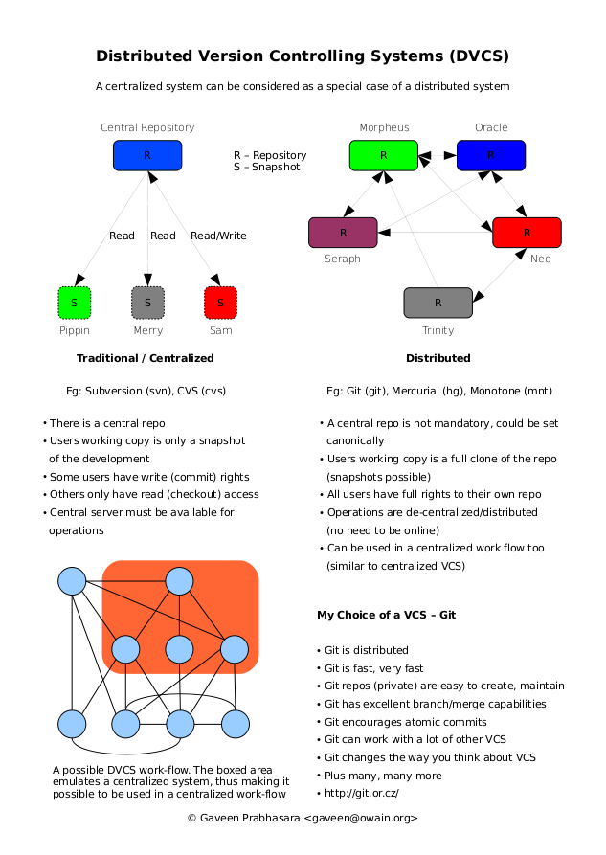
DVCS

Slide 3
Intro to DVCS with Hg
TortoiseHg - http://tortoisehg.bitbucket.org/
Learning - http://hginit.com/

Slide 4
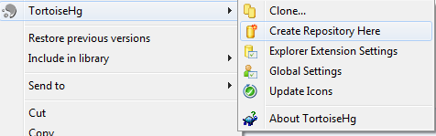
Init
hg init
hgtk – right click, initialize repo

Slide 5

Add/Remove
hg add, hg remove, hg addr
hgtk - right click, Hg Commit or Hg Workbench
add file
commit
modify file
commit
delete file
commit

Slide 6
Hg Workbench
AIO FTW – dedicated monitor
Repositories
History (vs hg log)
Diff
WIP
Status (vs hg status)
Diff (vs hg diff)
Unified
Changed
External
Commit w/ Message

Slide 7
More commands
Revert
Update
Shelve/Unshelve

Slide 8
Pushing
Create another repo
hg init
hg serve (web server, configurable)
Set upstream
filesystem, http/s, etc
Push changes
Review in browser

Slide 9
Cloning
hg clone (central repo)
review log!

Slide 10
Pulling
Change recipe
Push
Pull

Slide 11
Merging
Initial repo: Change recipe
Clone repo: Change recipe
Initial: push
Clone
Try Push
abort: push creates new remote heads on branch 'default'!
Check incoming
Pull
Post Pull – Nothing
Show log
Push
Initial
Pull w/ update

Slide 12
Rebasing
Initial repo: Add dessert.txt
Clone repo: Change recipe
Initial: push
Clone
Check incoming
Pull w/ rebase
Show log
Push
Initial
Pull w/ update
Show log

Slide 13
?s

Slide 14
Productivity with DVCS

Slide 15
Address Frustrations w/ VCS

Slide 16
Resources
http://geekswithblogs.net/wesm/archive/2010/04/28/how-i-do-vcs.aspx
http://geekswithblogs.net/wesm/archive/2011/02/06/things-ive-noticed-with-dvcs.aspx

Slide 17
Problem: Offline Access
hg clone https://wes_mcclure@bitbucket.org/lincolndev/lincolndev.net
Unplug internets
Open Hg Workbench!
History
Go back in time
Search
Commits

Slide 18
Problem: Merge Conflicts
Solution: Increase Frequency of Commits
Smaller commits
Easier to visualize conflicts

Slide 19
Problem: Large Incoherent Commits
Solution: Increase Frequency of Commits
Isolate intent
Add confidence

Slide 20
Problem: Infrequent Integration
Requiring integration to commit decreases frequency of commits and integration
Solution: Separate commit from integration
Increases frequency of commits
Easier to integrate

Slide 21
Problem: Unwanted Code
Solution: AIO tool
Easy to review commits

Slide 22
Problem: Commit without Message
Solution: AIO tool
Easy to add message
Solution: Increase frequency of commits
Smaller messages
Easier to describe

Slide 23
Problem: Visualizing Integration
Solution: AIO tool
Easier to
View log
See other contributions
Integrate
Stay focused

Slide 24
Problem: Exploratory coding
Solution: Throw away commits
Frequent commits isolates our work
Revert the whole commit!
Why waste time deciphering what you do/don’t need
Solution: Stash/Shelve

Slide 25
Problem: Exploding tasks
Solution: Local broken commits
Partial commits
Break tasks down
Push when ready

Slide 26
Problem: Branching
Sucked historically
Solution: Local branching
Anonymous branches
Named branches
Visualizing
Merging

Slide 27
Productivity & Git
Unlimited stashes
anonymous local branches
Use for config changes between environments
Unlimited rollback
git reset --soft HEAD~1
Rollup commits
Fix mistakes

Slide 28
?s

Slide 29
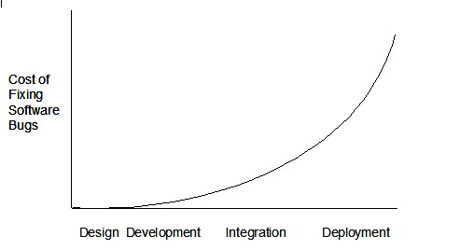
Continuous Integration

Slide 30
CCNet Resources
Free
ThoughtWorks
http://confluence.public.thoughtworks.org/display/CCNET/Welcome+to+CruiseControl.NET
GUI config
http://ccnetconfig.codeplex.com/
Not maintained

Slide 31
Automated Feedback
Failures
Build Failures
Missing Artifacts
Broken Tests
Success
Team feedback
Agile metrics
CCNet
Server
Config Validator
Project Config
Documentation - http://build.sharpdevelop.net/ccnet/doc/CCNET/
Site
CC Tray

